Slide 1




Slide 2


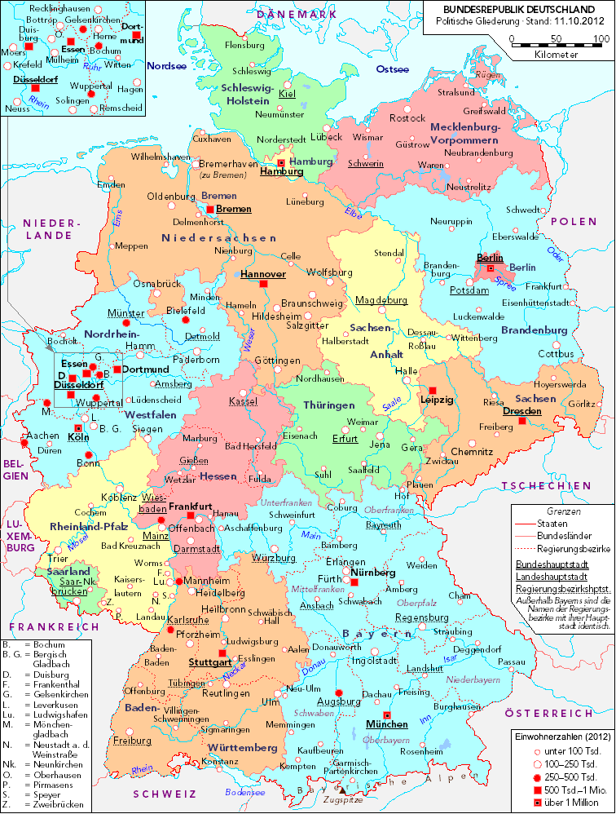
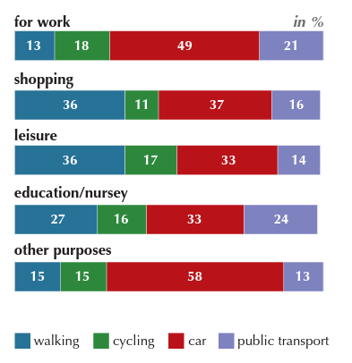
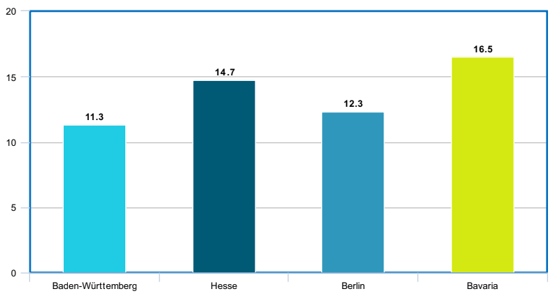
%
Statistics of people living a completely healthy life (Wikipedia)
Notes:
http://www.worldometers.info/world-population/germany-population/

Slide 3







Slide 4






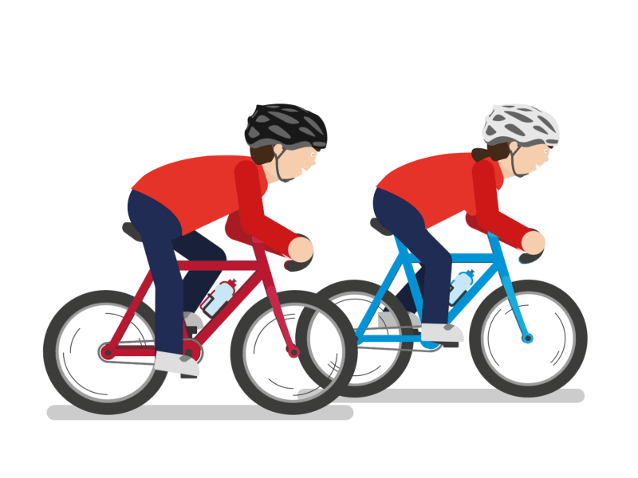




Slide 5











Slide 6











Slide 7


